Slide 1

ANAND ENGINEERING COLLEGE
Project On
BIG DATA WEATHER ANALYSIS USING APACHE HIVE
Presented By:
RINSHITA
CSE Final Year

Slide 2
Big Data is a term that describe voluminous volume of data- both structured and unstructured data that is difficult to process using traditional database processors and software techniques.
Big Data requires different tools and architecture to analyze the data computationally and to reveal the behavior, interaction, trends, patterns etc. all over the world.

Slide 3
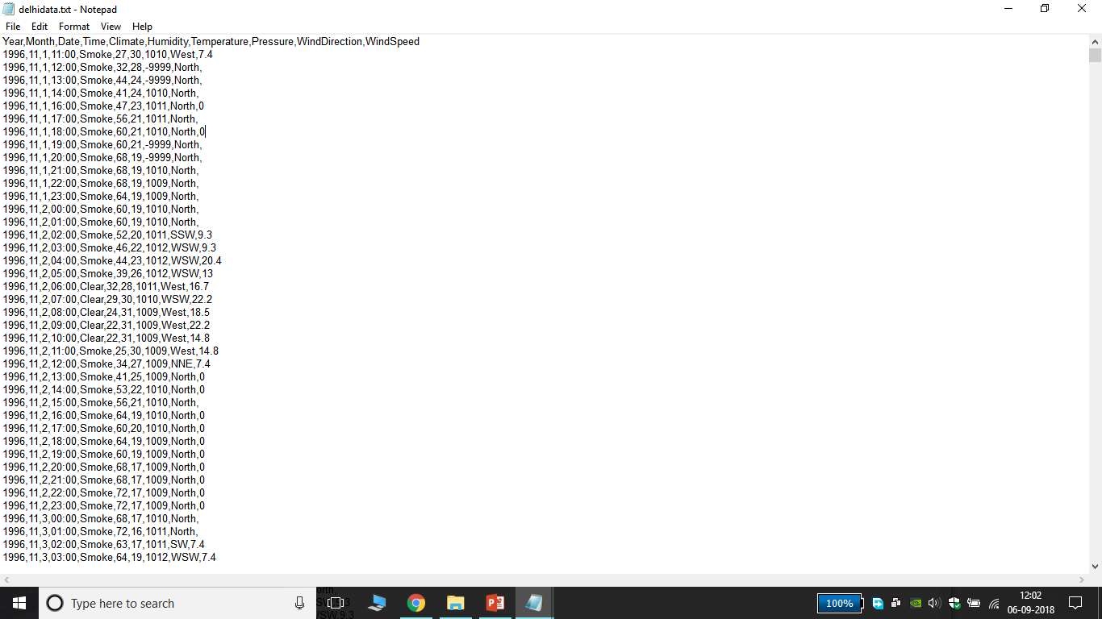
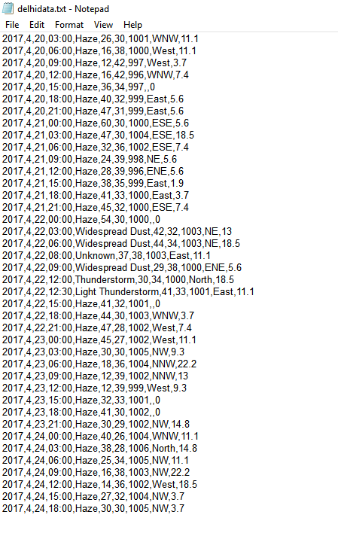
DELHI WEATHER DATA (1996 -2017)
YEAR
MONTH
DATE
TIME (min : sec)
CLIMATE
HUMIDITY
TEMPERATURE
PRESSURE
WIND DIRECTION
WIND SPEED

Slide 4

APACHE HIVE
HADOOP Tool to specially used to analyze large data sets easily with the help of few queries.
Apache Hive is a data warehouse software project built on top of Apache Hadoop for providing data query and analysis.
Hive gives an SQL-like interface to query data stored in various databases and file systems that integrate with Hadoop

Slide 5
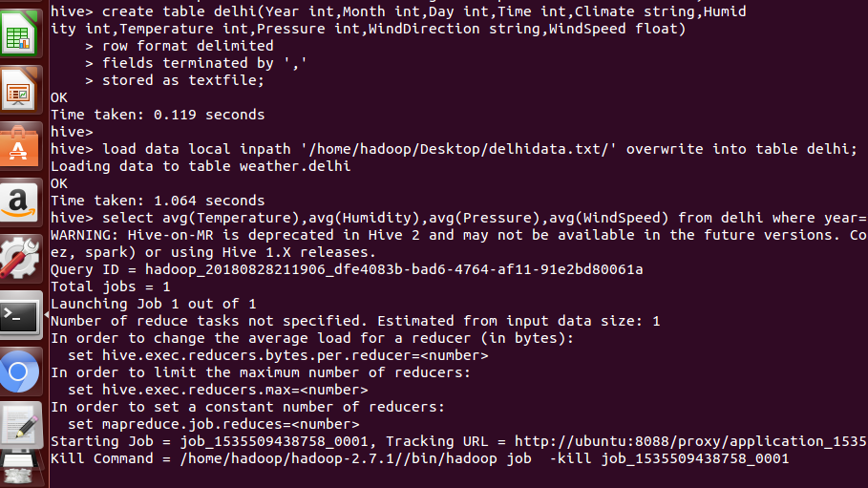
CREATING TABLE IN HIVE
LOADING
delhidata.txt file in table Delhi

Slide 6
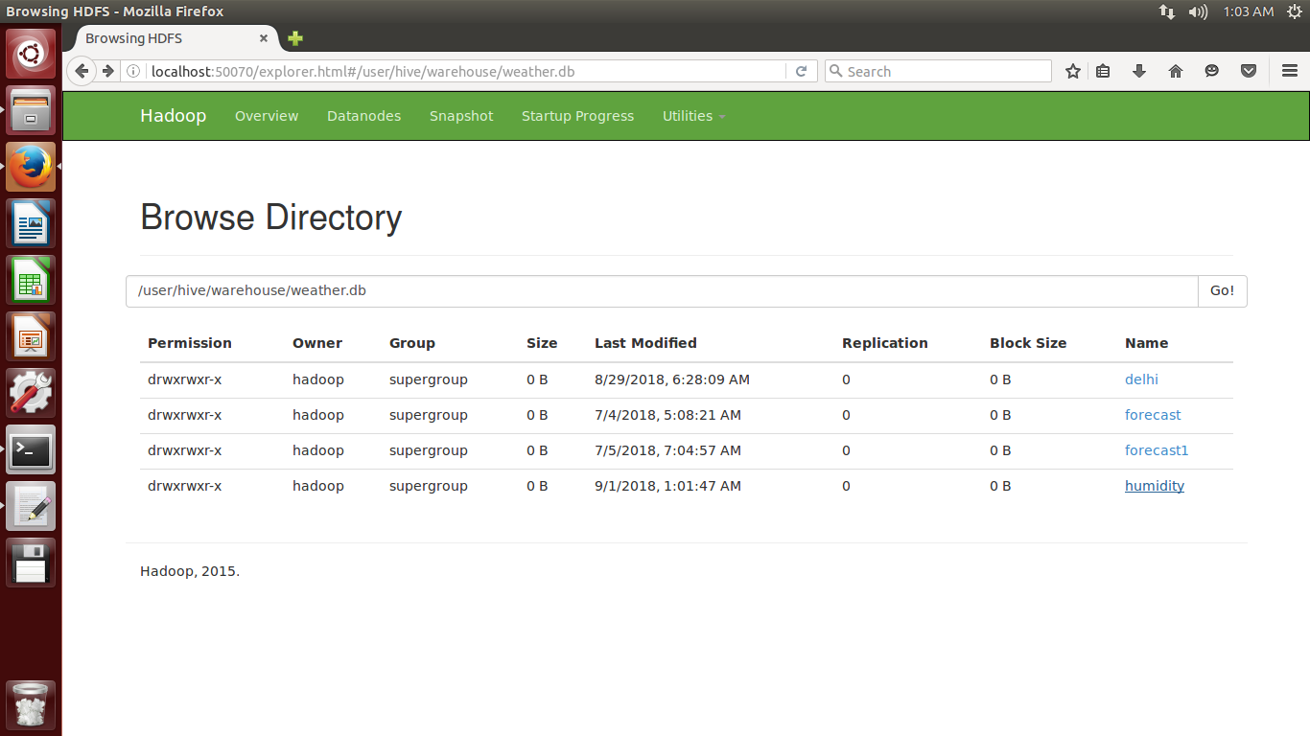
Hadoop Distributed File System(HDFS)
The Hadoop Distributed File System (HDFS) is the primary data storage system used by Hadoop applications.
Here Delhi table is created in Weather directory.

Slide 7
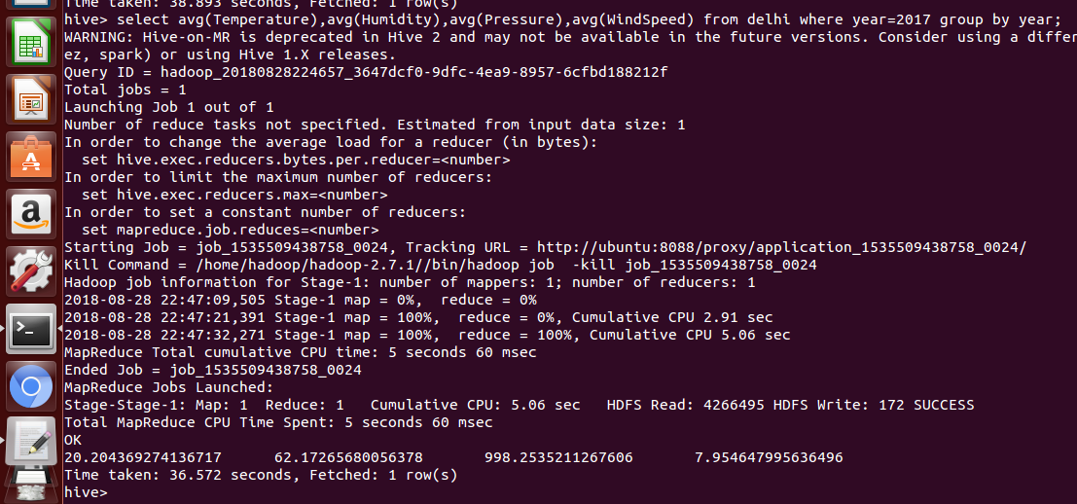
HIVE USE CASES
Finding Average Temperature of each year(1997-2017) with the help of hive query:
SELECT AVG(Temperature) from delhi where year=…… group by year;

Slide 8
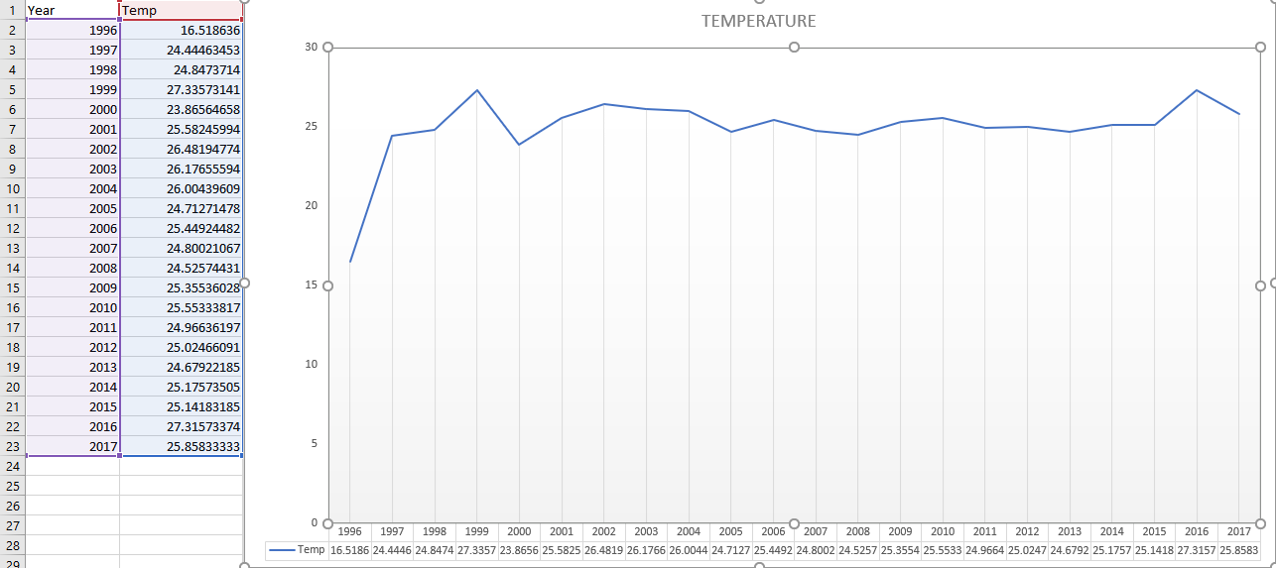
ANALYSIS ON THE BASIS OF AVERAGE TEMPERATURE

Slide 9
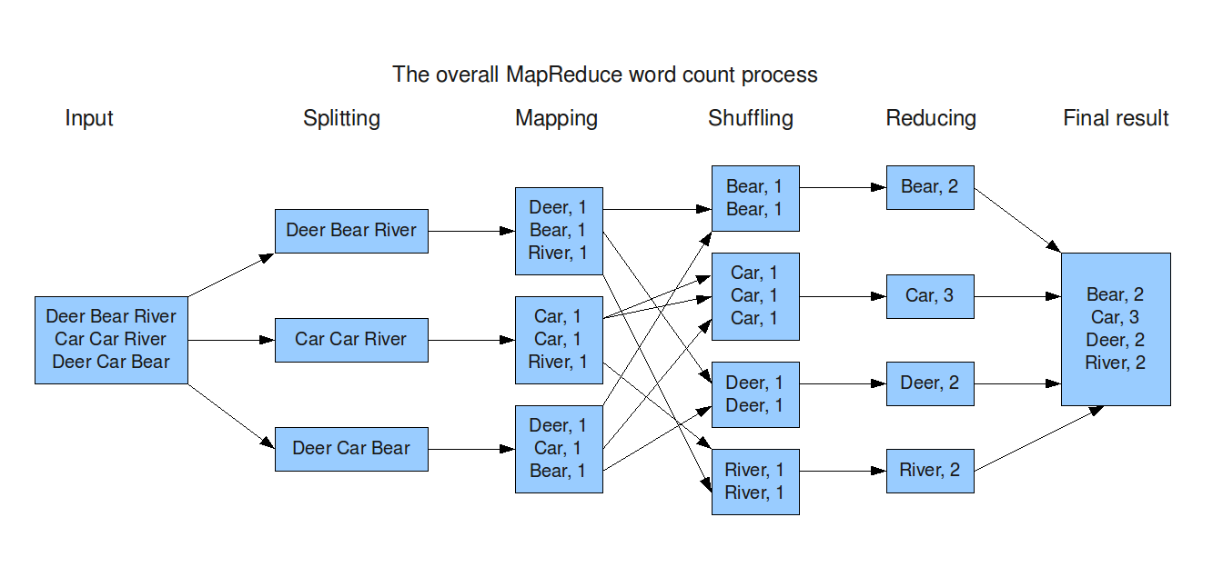
MAP REDUCING
MapReduce is the processing layer of Hadoop.
MapReduce programming model is designed for processing large volumes of data in parallel by dividing the work into a set of independent tasks.
The framework sorts the outputs of the maps, which are then input to the reduce tasks.
Mostly used in word count process.
WORD COUNT PROCESS

Slide 10
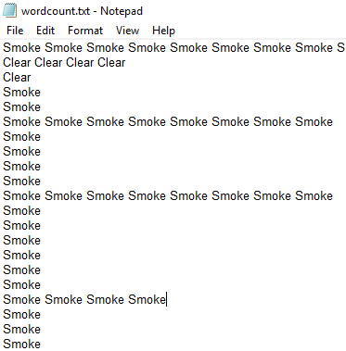
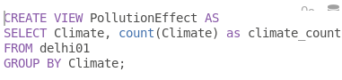
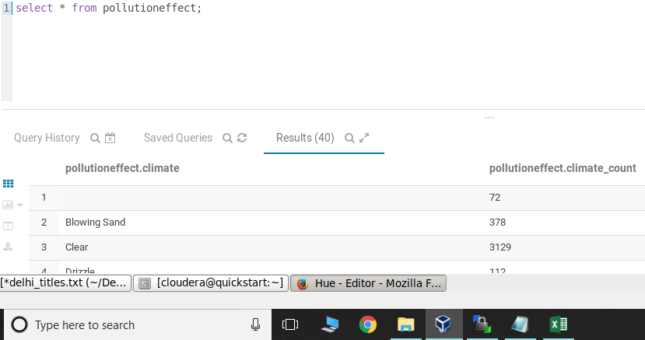
USE OF WORDCOUNT
HIVE QUERY:
Wordcount file contains the unstructured data of column (climate) from table Delhi

Slide 11
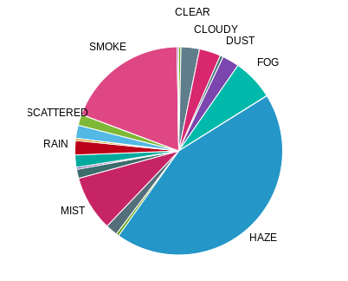
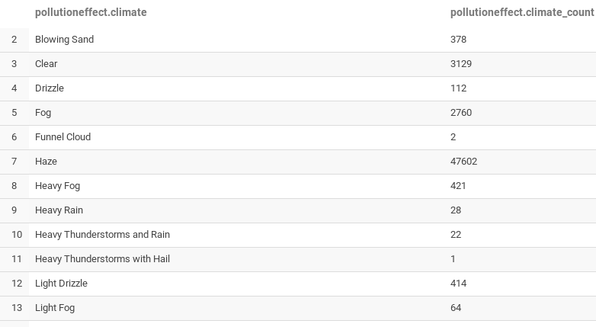
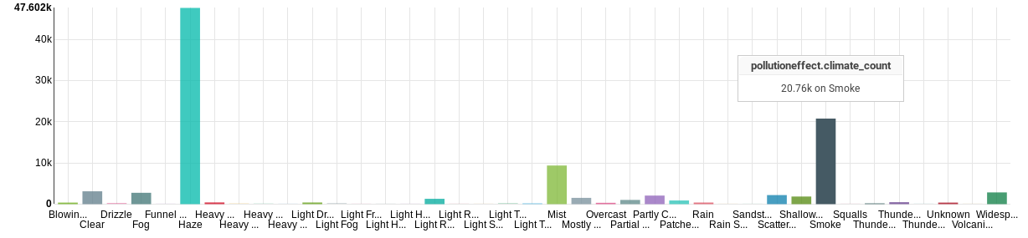
Analysis Of Climate Wordcount
HIGHEST WORDCOUNT OF HAZE

Slide 12
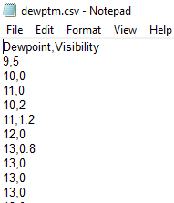
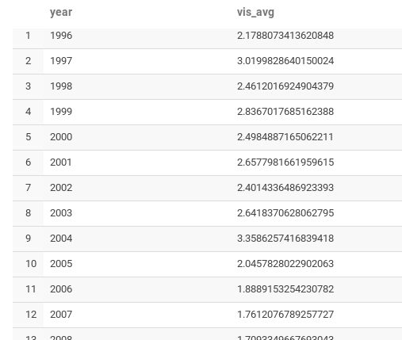
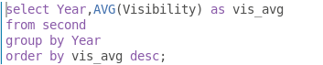
FINDING VISIBILITY AVERAGE OF EACH YEAR
Loading another file
RESULT
QUERY

Slide 13
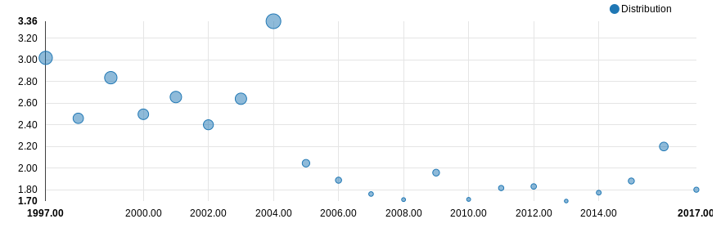
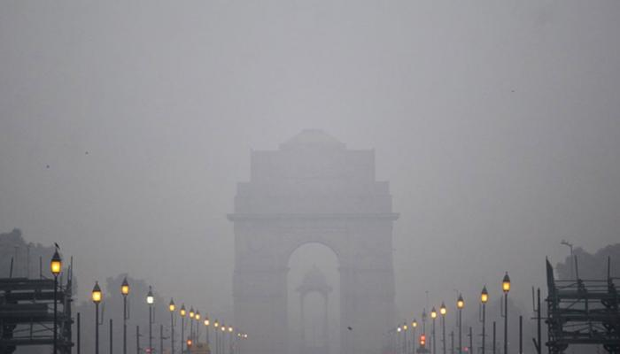
Analysis Of Visibility
The effect of decreasing visibility in the capital city is getting worse day by day.

Slide 14
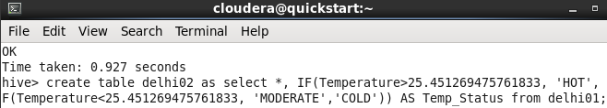
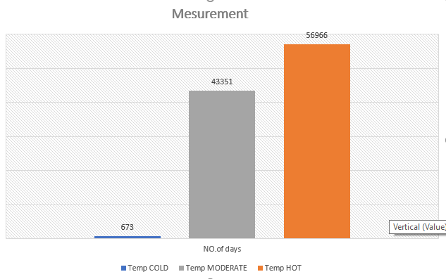
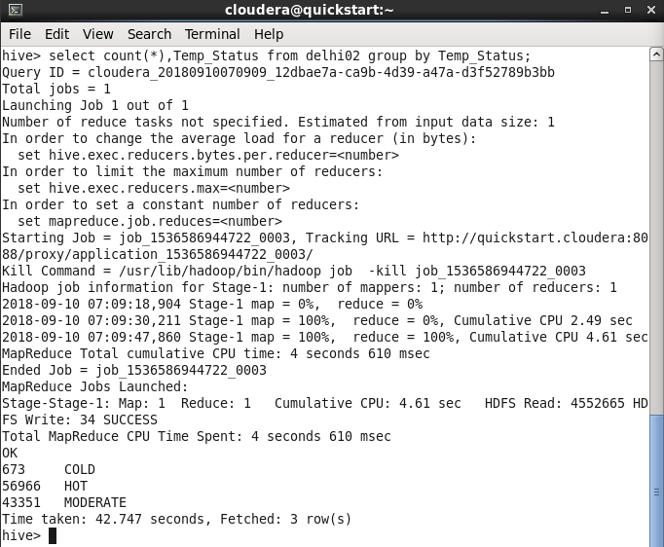
FINDING THE STATUS OF TEMPERATURE BY COMPARING WITH AVERAGE TEMP
Creating table and comparing Temperature
Analysis
Using COUNT() Function

Slide 15
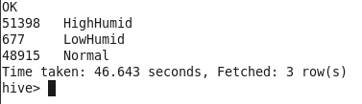
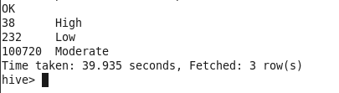
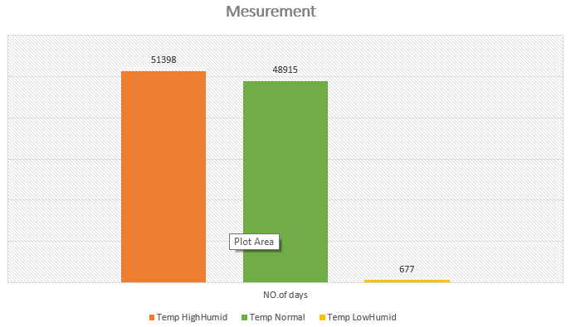
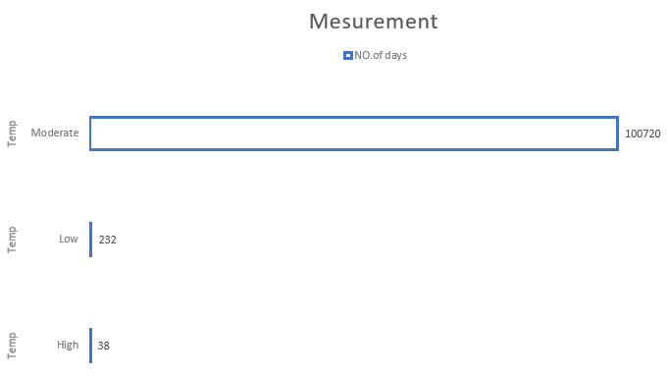
SIMILAR ANALYSIS OF HUMIDITY AND PRESSURE
HUMIDITY
PRESSURE

Slide 16
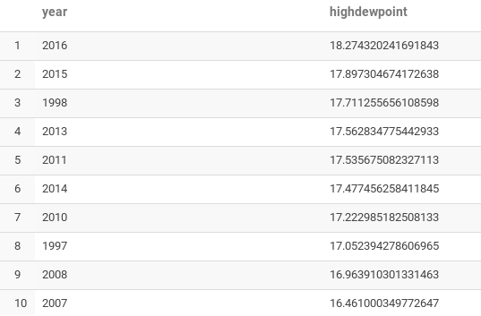
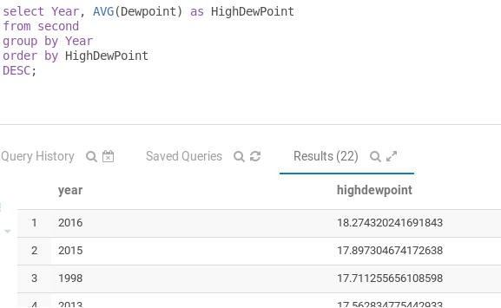
FINDING AVERAGE DEWPONT OF EACH YEAR

Slide 17
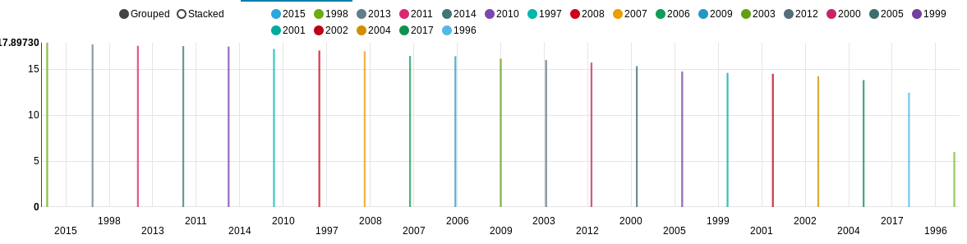
DEWPOINT ANALYSIS OF EACH YEAR IN DECREASNG ORDER

Slide 18
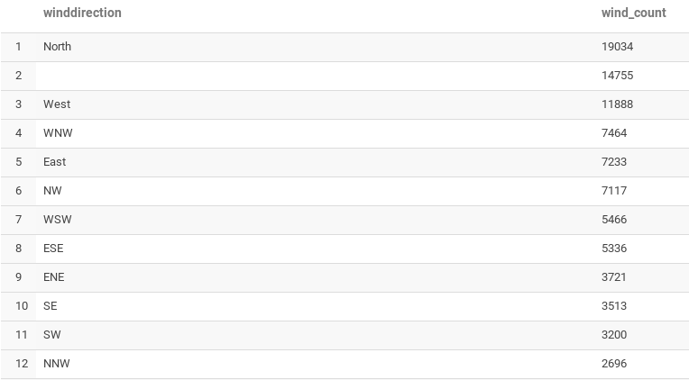

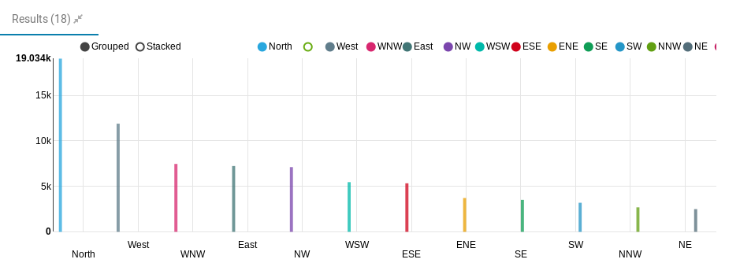
FINDIND AND ANALYZING WORDCOUNT OF WIND DIRECTION

